Slide 1
Text function – RIGHT function
Overview
Syntax
TEXT functions allow you to modify, manipulate, and search text data in order to increase the utility of text data in excel
RIGHT function allows you to select a substring from a string
RIGHT function returns the number of characters from a string, starting from the end of the string
=RIGHT(text, [number of characters])
=RIGHT(string you are using, OPTIONAL: the number of characters you are looking for from the string, starting from the end of the string – DEFAULT: 1)
Uses and Applications
Tips and Tricks
Use RIGHT to clean data or to get substrings or characters from texts
Combine with other text functions to extract specific text strings
Use RIGHT with LEN and FIND to make the function more dynamic
Counts each character even if it is a space
Remember to clean the data as much as you can before you use RIGHT (e.g., TRIM)
Function
Input Criteria
Excel Defined Criteria

Slide 2
Text function – LEFT function
Overview
Syntax
TEXT functions allow you to modify, manipulate, and search text data in order to increase the utility of text data in excel
LEFT function allows you to select a substring from a string
LEFT function returns the number of characters from a string, starting from the start of the string
=LEFT(text, [number of characters])
=LEFT(string you are using, OPTIONAL: the number of characters you are looking for from the string, starting from the start of the string – DEFAULT: 1)
Uses and Applications
Tips and Tricks
Use LEFT to clean data or to get substrings or characters from texts
Combine with other text functions to extract specific text strings
Use LEFT with LEN and FIND to make the function more dynamic
Counts each character, even if it is a space
Remember to clean the data as much as you can before you use LEFT (e.g., TRIM)
Function
Input Criteria
Excel Defined Criteria

Slide 3
Text function – FIND function
Overview
Syntax
TEXT functions allow you to modify, manipulate, and search text data in order to increase the utility of text data in excel
FIND function looks for a specific text string within another text string
FIND function returns the numerical position of text within a cell
=FIND(find_text, within_text, [start_num])
=FIND(what text are you looking for, the cell in which you want to locate your text, OPTIONAL: the first character to start looking within the cell, if omitted will start at 1)
Uses and Applications
Tips and Tricks
Searching among unstructured datasets
Combine with other text functions to extract specific text strings
Function is case-sensitive
Counts each character, even if it is a space
Will return the first instance of found text in the searched text string
#VALUE! error is displayed when text is not found
Function
Input Criteria
Array
Excel Defined Criteria

Slide 4
Text function – MID function
Overview
Syntax
TEXT functions allow you to modify, manipulate, and search text data in order to increase the utility of text data in excel
MID function allows you to select a substring from a string
MID function returns the number of characters from a string starting from the start of the string, where you have defined start_num
=MID(text, start num, number of characters)
=MID(string you are using, when do you want your substring to start; beginning from the start of the text, the number of characters you are looking for from the string, starting from start num)
Uses and Applications
Tips and Tricks
Use MID to clean data or to get substrings or characters from texts
Combine with other text functions to extract specific text strings
Use MID with LEN and FIND to make the function more dynamic
Counts each character, even if it is a space
Remember to clean the data as much as you can before you use MID (e.g., TRIM)
Function
Input Criteria
Excel Defined Criteria

Slide 5
Text function – LEN function
Overview
Syntax
TEXT functions allow you to modify, manipulate, and search text data in order to increase the utility of text data in excel
LEN function counts the number of characters from a provided text
LEN function returns the number of characters from provided text
=LEN(text)
=LEN(the text that you want the character count for)
Uses and Applications
Tips and Tricks
Use the string to count characters in text
Combine with other text functions to extract specific text strings
Counts each character, even if it is a space
Very useful when combined with FIND, LEFT, RIGHT, and/or MID text functions
Helpful to locate non-visible characters (e.g., newline, carriage return, spaces)
Function
Input Criteria
Array
Excel Defined Criteria

Slide 6
Text function – PROPER function
Overview
Syntax
TEXT functions allow you to modify, manipulate, and search text data in order to increase the utility of text data in excel
PROPER function allows you to quickly format text for proper nouns
PROPER function returns ‘properly’ formatted text where the first letter is capitalized and all other characters of a word is in lowercase
=PROPER (text)
=PROPER (text you want to format as a proper noun)
Uses and Applications
Tips and Tricks
Use to format names or titles
Use it to correct capitalization (lowercase, uppercase) issues
Use this function to ensure words are appropriately capitalized
Function
Input Criteria
Array
Excel Defined Criteria

Slide 7
Text function – CONCATENATE function
Overview
Syntax
TEXT functions allow you to modify, manipulate, and search text data in order to increase the utility of text data in excel
CONCATENATE function allows users to develop text strings from multiple inputs
CONCATENATE function returns a text string built from all input information (text, data)
=CONCATENATE(text_1, [text_2],...)
=CONCATENATE(text you want to concatenate, OPTIONAL: text you want to concatenate to all previous text,… OPTIONAL: Additional text to concatenate)
Uses and Applications
Tips and Tricks
Compile custom text strings quickly from data in your model
Combine with other text functions to extract specific text strings
Quickly build text strings from data inputs
Interchangeable with “&”
Will return the first instance of found text in the searched text string
#VALUE! error is displayed when text not found
Function
Input Criteria
Array
Excel Defined Criteria

Slide 8
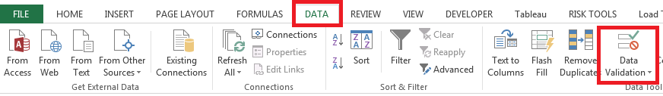
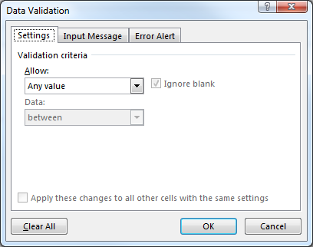
Text function – Data validation
Overview
Syntax
TEXT functions allow you to modify, manipulate, and search text data in order to increase the utility of text data in excel
Data Validation is a functionality that allows you to limit potential inputs from users
Data Validation allows a user to enter data or returns an error to the user through excel, based on inputs and limits imposed on a cell
Uses and Applications
Tips and Tricks
Use Data Validation to make sure that users enter certain values into a cell
Combine with other text functions to extract specific text strings
Use Data Validation to quickly fill in columns of data through enabled lists
Use the error message to help users understand why their data is not allowed
Use warn or reject depending on your model’s data sensitively

Slide 9
Text function – UPPER function
Overview
Syntax
TEXT functions allow you to modify, manipulate, and search text data in order to increase the utility of text data in excel
UPPER function allows you to quickly format text in uppercase
UPPER function returns uppercase formatted text
=UPPER(text)
=UPPER(text you want to format in uppercase)
Uses and Applications
Tips and Tricks
Use to format text for search or data cleansing
Use it to correct capitalization (lowercase, uppercase) issues
Use doesn’t effect FIND, SEARCH, VLOOKUP functions
this function to ensure character case Use this function to clean data
Function
Input Criteria
Array
Excel Defined Criteria

Slide 10
Text function – LOWER function
Overview
Syntax
TEXT functions allow you to modify, manipulate, and search text data in order to increase the utility of text data in excel
LOWER function allows you to quickly format case for
LOWER function returns lowercase formatted text
=LOWER(text)
=LOWER(text you want to format in lowercase)
Uses and Applications
Tips and Tricks
Use to format text for search or data cleansing
Use it to correct capitalization (lowercase, uppercase) issues
Use this function to ensure character case doesn’t effect FIND, SEARCH, VLOOKUP functions
Use this function to clean data
Function
Input Criteria
Array
Excel Defined Criteria

